Slide 1
Higher Education Retention
By: Jimilia Harris, Lan Dinh, Takiyah Green, Lemuel Mutah, Jordan Hunt

Slide 2
Overview
Potholes on the Road to College: High School Effects in Shaping Urban Students’ Participation in College Applications, Four-Year College Enrollment, and College Match
Authors: Melissa Roderick, Vanessa Coca, Jenny Nagaoke
Institution: University of Chicago

Slide 3
Problem
Where reform needs to made in order to bridge the gap between urban high school graduates’ goal and execution of attending a 4-year college?

Slide 4
Assumption in Previous Work
College cost and credit constraints
  High college costs and limited borrowing options
  Lack of attended high schools that properly guide students to college

Slide 5
Insight
Among the many factors that affect the enrollment of low income students into 4-year colleges, there is a correlation between the support given from high schools and the students’ successfulness in enrolling
Prior research surrounding this topic has been done, which is used as a background and explanation to the purpose of this study.

Slide 6
Proof
Potholes on the Road to College utilizes 3 methods:
  Broad proxy measure - students from the previous graduating class were used as a reference
  Indicators of engagement for college geared high school activities
  Measurement of college going climate
    College-going climate - environment in which the teachers set high expectations and support for collegiate aspirations

Slide 7
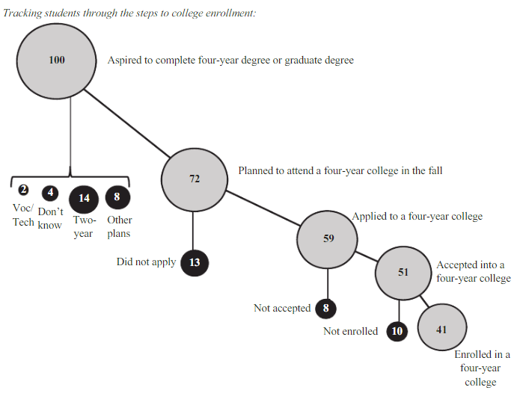
Visualization
The paper highlights the consistencies of the presence of college-going climate on students of varying external factors.

Slide 8
Impact
This paper encourages a shifts focus to the disparities that low-income students face in ways that have not been previously considered.
The thoughts surrounding the lack of enrollment in 4-year colleges by low-income students will no longer center finances, but will also further discussion on how to better aid the students.

Slide 9
Equity Gaps African American Students
The Illinois Board of Higher Education's strategic plan, "A Thriving Illinois," outlines a vision for advancing the state's higher education system to foster an inclusive economy and broad prosperity. The plan is centered on main goals of equity, sustainability, and growth.
Significant equity gaps that African American students in higher education face are highlighted in the report by the Illinois Board of Higher Education. Higher education must cater to students throughout their lives, including those needing to review or deepen understanding and address barriers to higher education, such as access to early college experiences, developmental education, retention, advancement, and career outcomes.
They believe that the system must also attract and support working adults who have not yet completed their education. This includes recognizing their unique needs and experiences. They want more targeted support such as summer courses, proactive advising, and wrap-around services. Institutions are encouraged to develop specific equity plans, analyze disaggregated data to identify intervention points, and conduct equity impact analyses before making decisions. Increasing representation in staff is key as well.

Slide 10
Bio Of Pedro A. Noguera
Pedro A. Noguera is the Distinguished Professor of Education at the Graduate School of Education and Information Studies and Faculty Director for the Center for the Transformation of Schools at UCLA. He is a sociologist whose scholarship and research focuses on the ways in which schools are influenced by social and economic conditions as well as by demographic trends in local, regional and global contexts. Some of his most prominent works are:
The achievement gap and the discipline gap: Two sides of the same coin?
The trouble with Black boys: The role and influence of environmental and cultural factors on the academic performance of African American males
The trouble with black boys:... And other reflections on race, equity, and the future of public education

Slide 11
Additional Reading
Research Article:
Laura Walter Perna (2000) Differences in the Decision to Attend College among African Americans, Hispanics, and Whites, The Journal of Higher Education, 71:2, 117-141, DOI: 10.1080/00221546.2000.11778831
Article #1:
Burke, Lindsey, and Jonathan Schwalbach. "Housing Redlining and Its Lingering Effects on Education Opportunity." The Heritage Foundation, 16 Dec. 2021, www.heritage.org/education/report/housing-redlining-and-its-lingering-effects-education-opportunity. Accessed 26 June 2024.
Article #2:
Smith, Ember, and Sarah Reber. “College Enrollment Gaps: How Academic Preparation Influences Opportunity.” Brookings, 23 Jan. 2023, www.brookings.edu/articles/college-enrollment-gaps-how-academic-preparation-influences-opportunity/#:~:text=High%20school%20students%20with%20high,status%2C%20gender%2C%20and%20race.

